Slide 1

教学辅助课件
牛津 七年级下

Slide 2
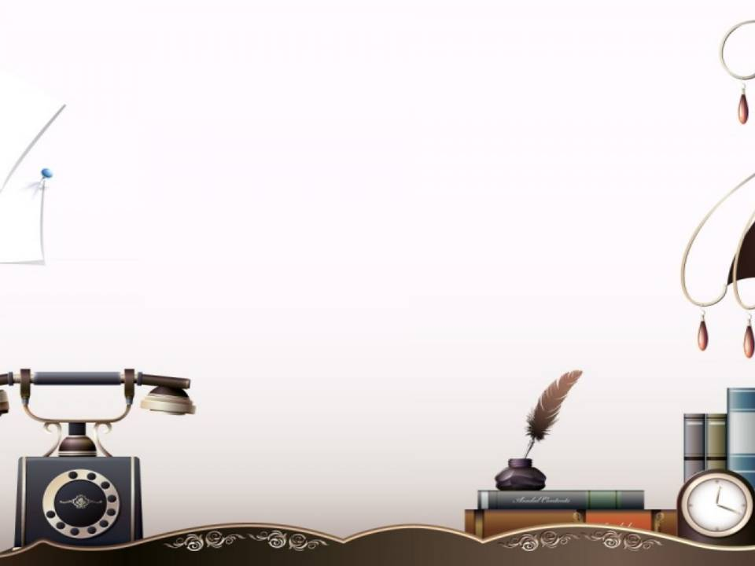



Unit 1
Dream homes
study skills

Slide 3
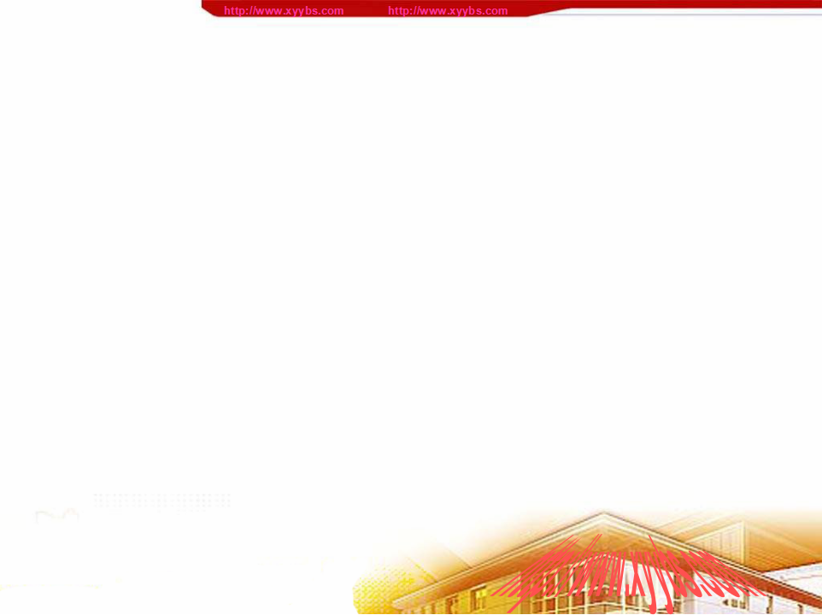

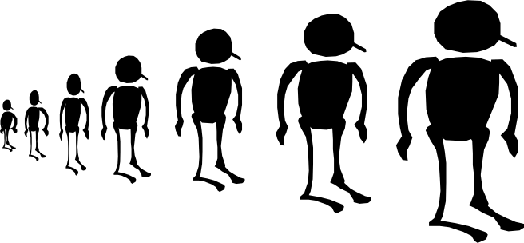
Objectives
To stress where stress falls in a word
To pronounce words with more than one syllable correctly

Slide 4

英文中有几个元音音素就有几个音节。
根据音节数的不同可分为：
下面的音标中各包含了几个元音音素？
/si:/ /flæt/
/'mesidʒ/ /læmp/
/fʊt/ /'bælkəni/
/'kæpitl/ /ri'membə/
/si:/ /flæt/
/'mesidʒ/ /læmp/
/fʊt/ /'bælkəni/
/'kæpitl/ /ri'membə/
重音符号
单音节词
双音节词
多音节词
单词的重音能在第一个，中间或最后一个音节上
重读的音节声音听起来更响亮

Slide 5
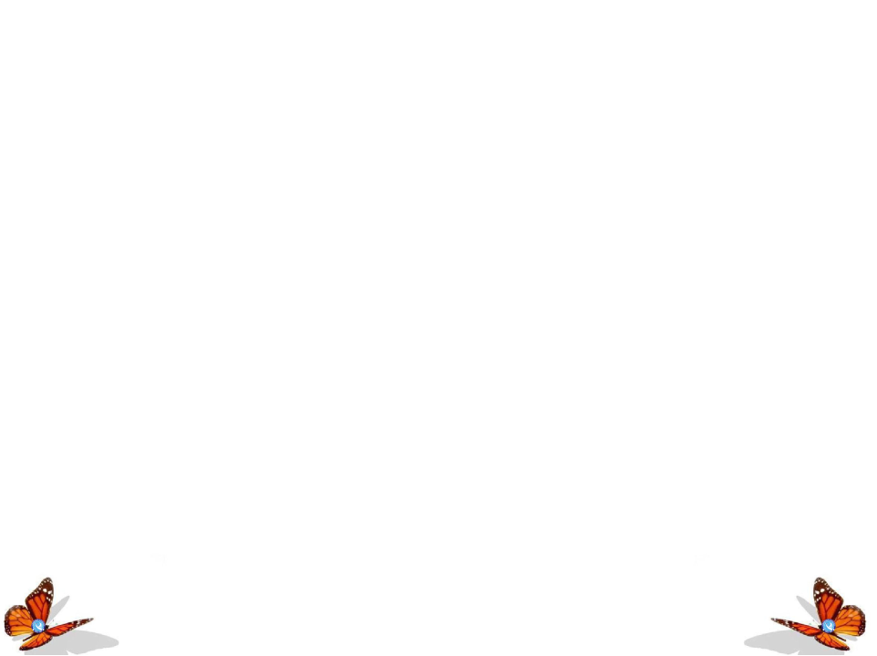


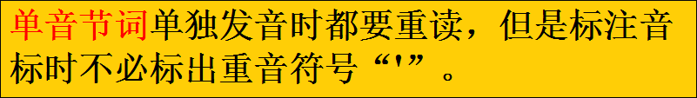
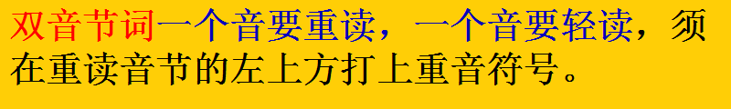

重音及读法

Slide 6
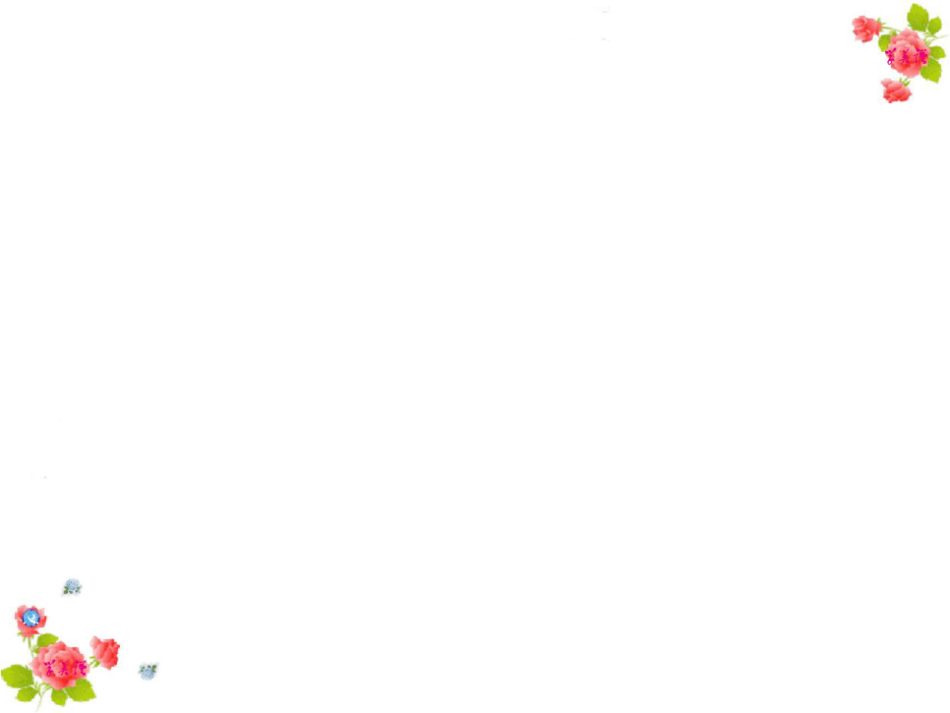


A
Listen and practice saying these words.
Stressing the second syllable
1 be·tween
2 en·joy
3 Hal·low·een
1 beau·ti·ful
2 coun·try
3 pal·ace
1 ex·pen·sive
2 po·ta·to
3 to·mor·row
Stressing the first syllable
Stressing the last syllable
P15

Slide 7


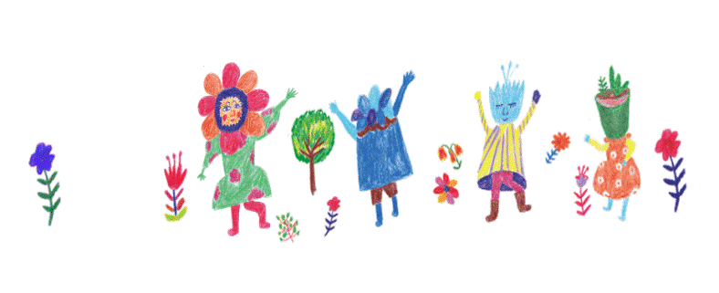
B
Listen and underline the stressed syllable of each word.
1 cen·tre
2 bath·room
3 hun·dred
4 Oc·to·ber
5 mes ·sage
6 in·clude
7 fa·vour·ite
8 won·der·ful
9 de·sign

Slide 8
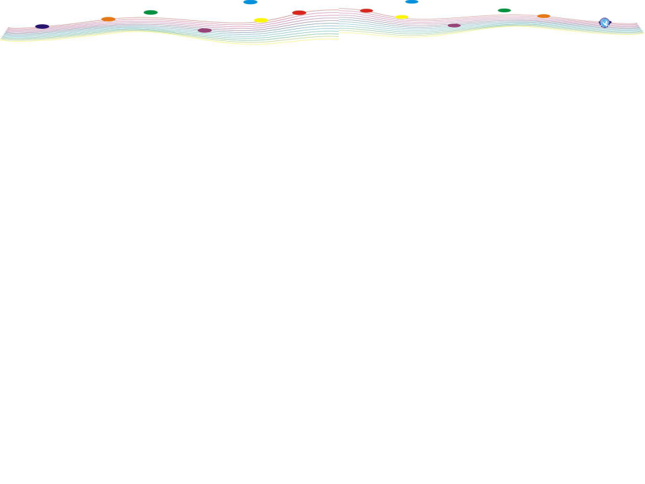






c
Work in pairs. Take turns to read the words in Part B aloud.
How to pronounce this word?
Which is the stressed syllable?
won·der·ful
Oc·to·ber
bath·room
in·clude
cen·tre
hun·dred
fa·vour·ite
de·sign
mes ·sage

Slide 9

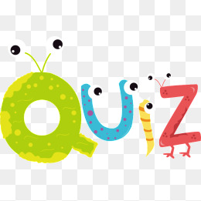


Slide 10

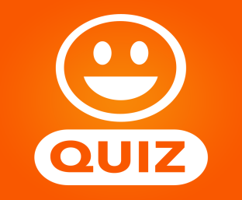

将下面方框中的单词按重音位置归类
palace, activity, capital, Japan, geography, Christmas
palace
capital
1. 重音在第一个音节：__________ __________
__________
2.重音在第二个音节： __________ __________
__________
Christmas
activity
Japan
geography
B
E

Slide 11
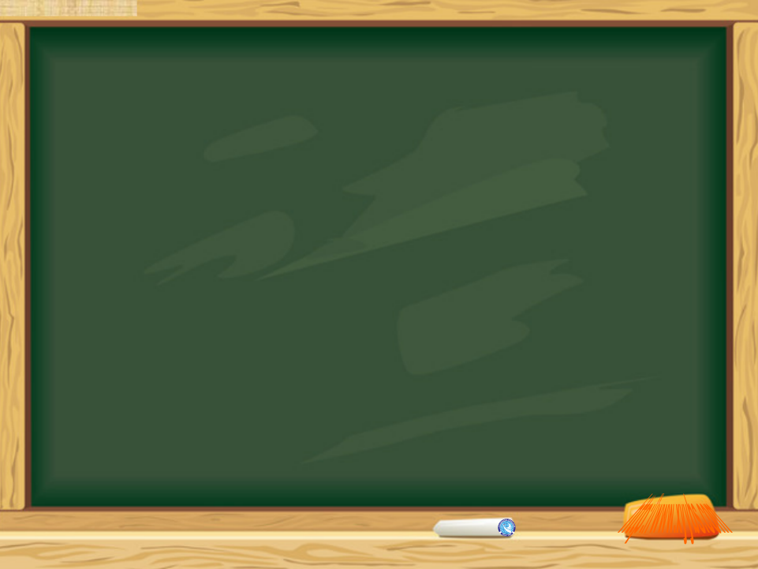

1. Read the words on page 15.
2. Preview Task on P16.

